Slide 1


Large language models and retrieval augmented generation

Slide 2

Topics
LARGE LANGUAGE MODELS (LLMs)
TRAINING AN LLM
LIMITATIONS OF PARAMETERIZED TRAINING
RETRIEVAL AUGMENTED GENERATION (RAG)
INCORPORATION AND IMPLEMENTATION

Slide 3

Large language models

Slide 4

Large Language Models
Language Models: one of the most prominent applications of Generative Artificial Intelligence.
Models can generate text by predicting the most likely following word in a sequence by using context between commonly occurring words, sentences, and language structures in training data.
Examples:
OpenAI’s ChatGPT – Chatbot
Amazon’s Alexa – Virtual Assistant
Notes:
Audience has certainly used LLMs without knowing it. End off talking about training data.

Slide 5

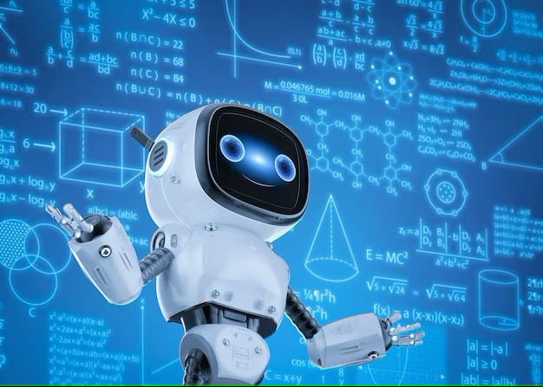
Training an llm

Slide 6
TRAINING AN LLM
The output of Large Language Models is determined by its parameters, which govern how it learns, adjusts and generates text. Parameters can be seen as the different features of an LLM, and its diversity in use cases.
Some Parameters Include:
Model Size – The number of parameters is a parameter itself.
Context Window – The span at which the LLM looks when determining relative context.
Adaptability – Models ability to perform more specialized tasks.
Training data – This is the dataset that the model is trained on, and the quality, quantity and structure of the data can all influence its generation abilities.
LLMs repeatedly adjusting parameters to increase accuracy of predictions throughout the learning period, as such, this method is known as parameterized training.
Notes:
Imagine a menu, with a lot of options that change your experience in the game. It is suggested that CGPT 3.5 uses around 175B parameters. CGPT 4 has around 1 trillion.

Slide 7

LIMITATIONS OF PARAMETERIZED TRAINING

Slide 8

LIMITATIONS OF PARAMETERIZED TRAINING
When initializing LLMs, the learning and correction process:
depletes large amounts of memory.
consumes large amounts of storage for its dataset.
takes very long.
These resources are often virtual, hosted on the cloud for scalability and availability. As such, the initialization process is often financially costly as well.
8

Slide 9
LIMITATIONS OF PARAMETERIZED TRAINING (CONT’d.)
The textual data used to train an LLM determines its behavior, and once the dataset is large, it can predict words in a large variety of contexts.
However, an LLM might not be exposed to certain information outside of its scope of training, or newly generated information.
Generally, this is the case in specific applications of LLMs such as in business solutions or the medical field.
In these cases, an LLM will need to be retrained, or fine-tuned to incorporate usage-specific data. This can significantly increase overhead costs and resource use.
9
Notes:
Mention ChatGPT 3.5 only being accurate up to January 2022.

Slide 10
LIMITATIONS OF PARAMETERIZED TRAINING (CONT’d.)
In some cases, retraining may not be needed as the behavior of the model is adequate to perform the given task, but the scope of knowledge is not broad enough to facilitate generation of updated or accurate knowledge.
Retrieval Augmented Generation can be useful in these situations…
10

Slide 11

RETRIEVAL AUGMENTED GENERATION

Slide 12
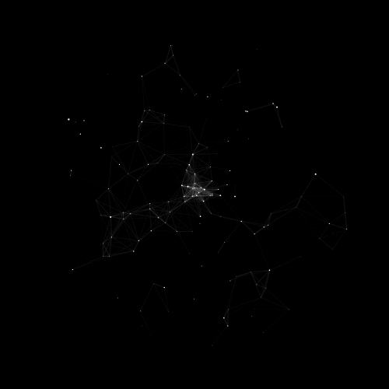
RETRIEVAL AUGMENTED GENERATION
Retrieval Augmented Generation (RAG) is the process by which LLMs fetch and reference information outside of their training dataset.
Notes:
The people who proposed RAG regret naming it that. Good moment for analogy.

Slide 13
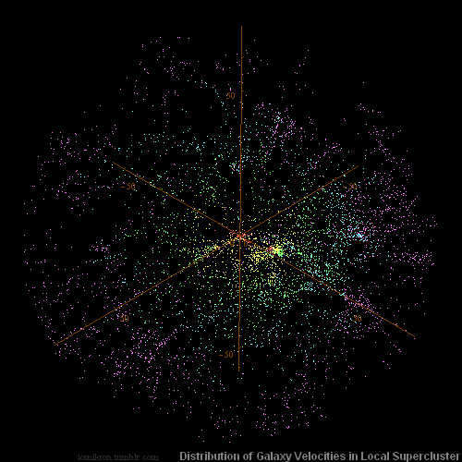
RETRIEVAL AUGMENTED GENERATION (CONT’D.)
With RAG, LLMs can access constantly updating information, and improve the utility of their responses to users.
By simply creating, updating or deleting data points in the datastore from which they draw information, the LLM can have access to new and accurate material for response generation.
Notes:
This means we do not have to retrain our model as often, or in specific use cases, at all.

Slide 14
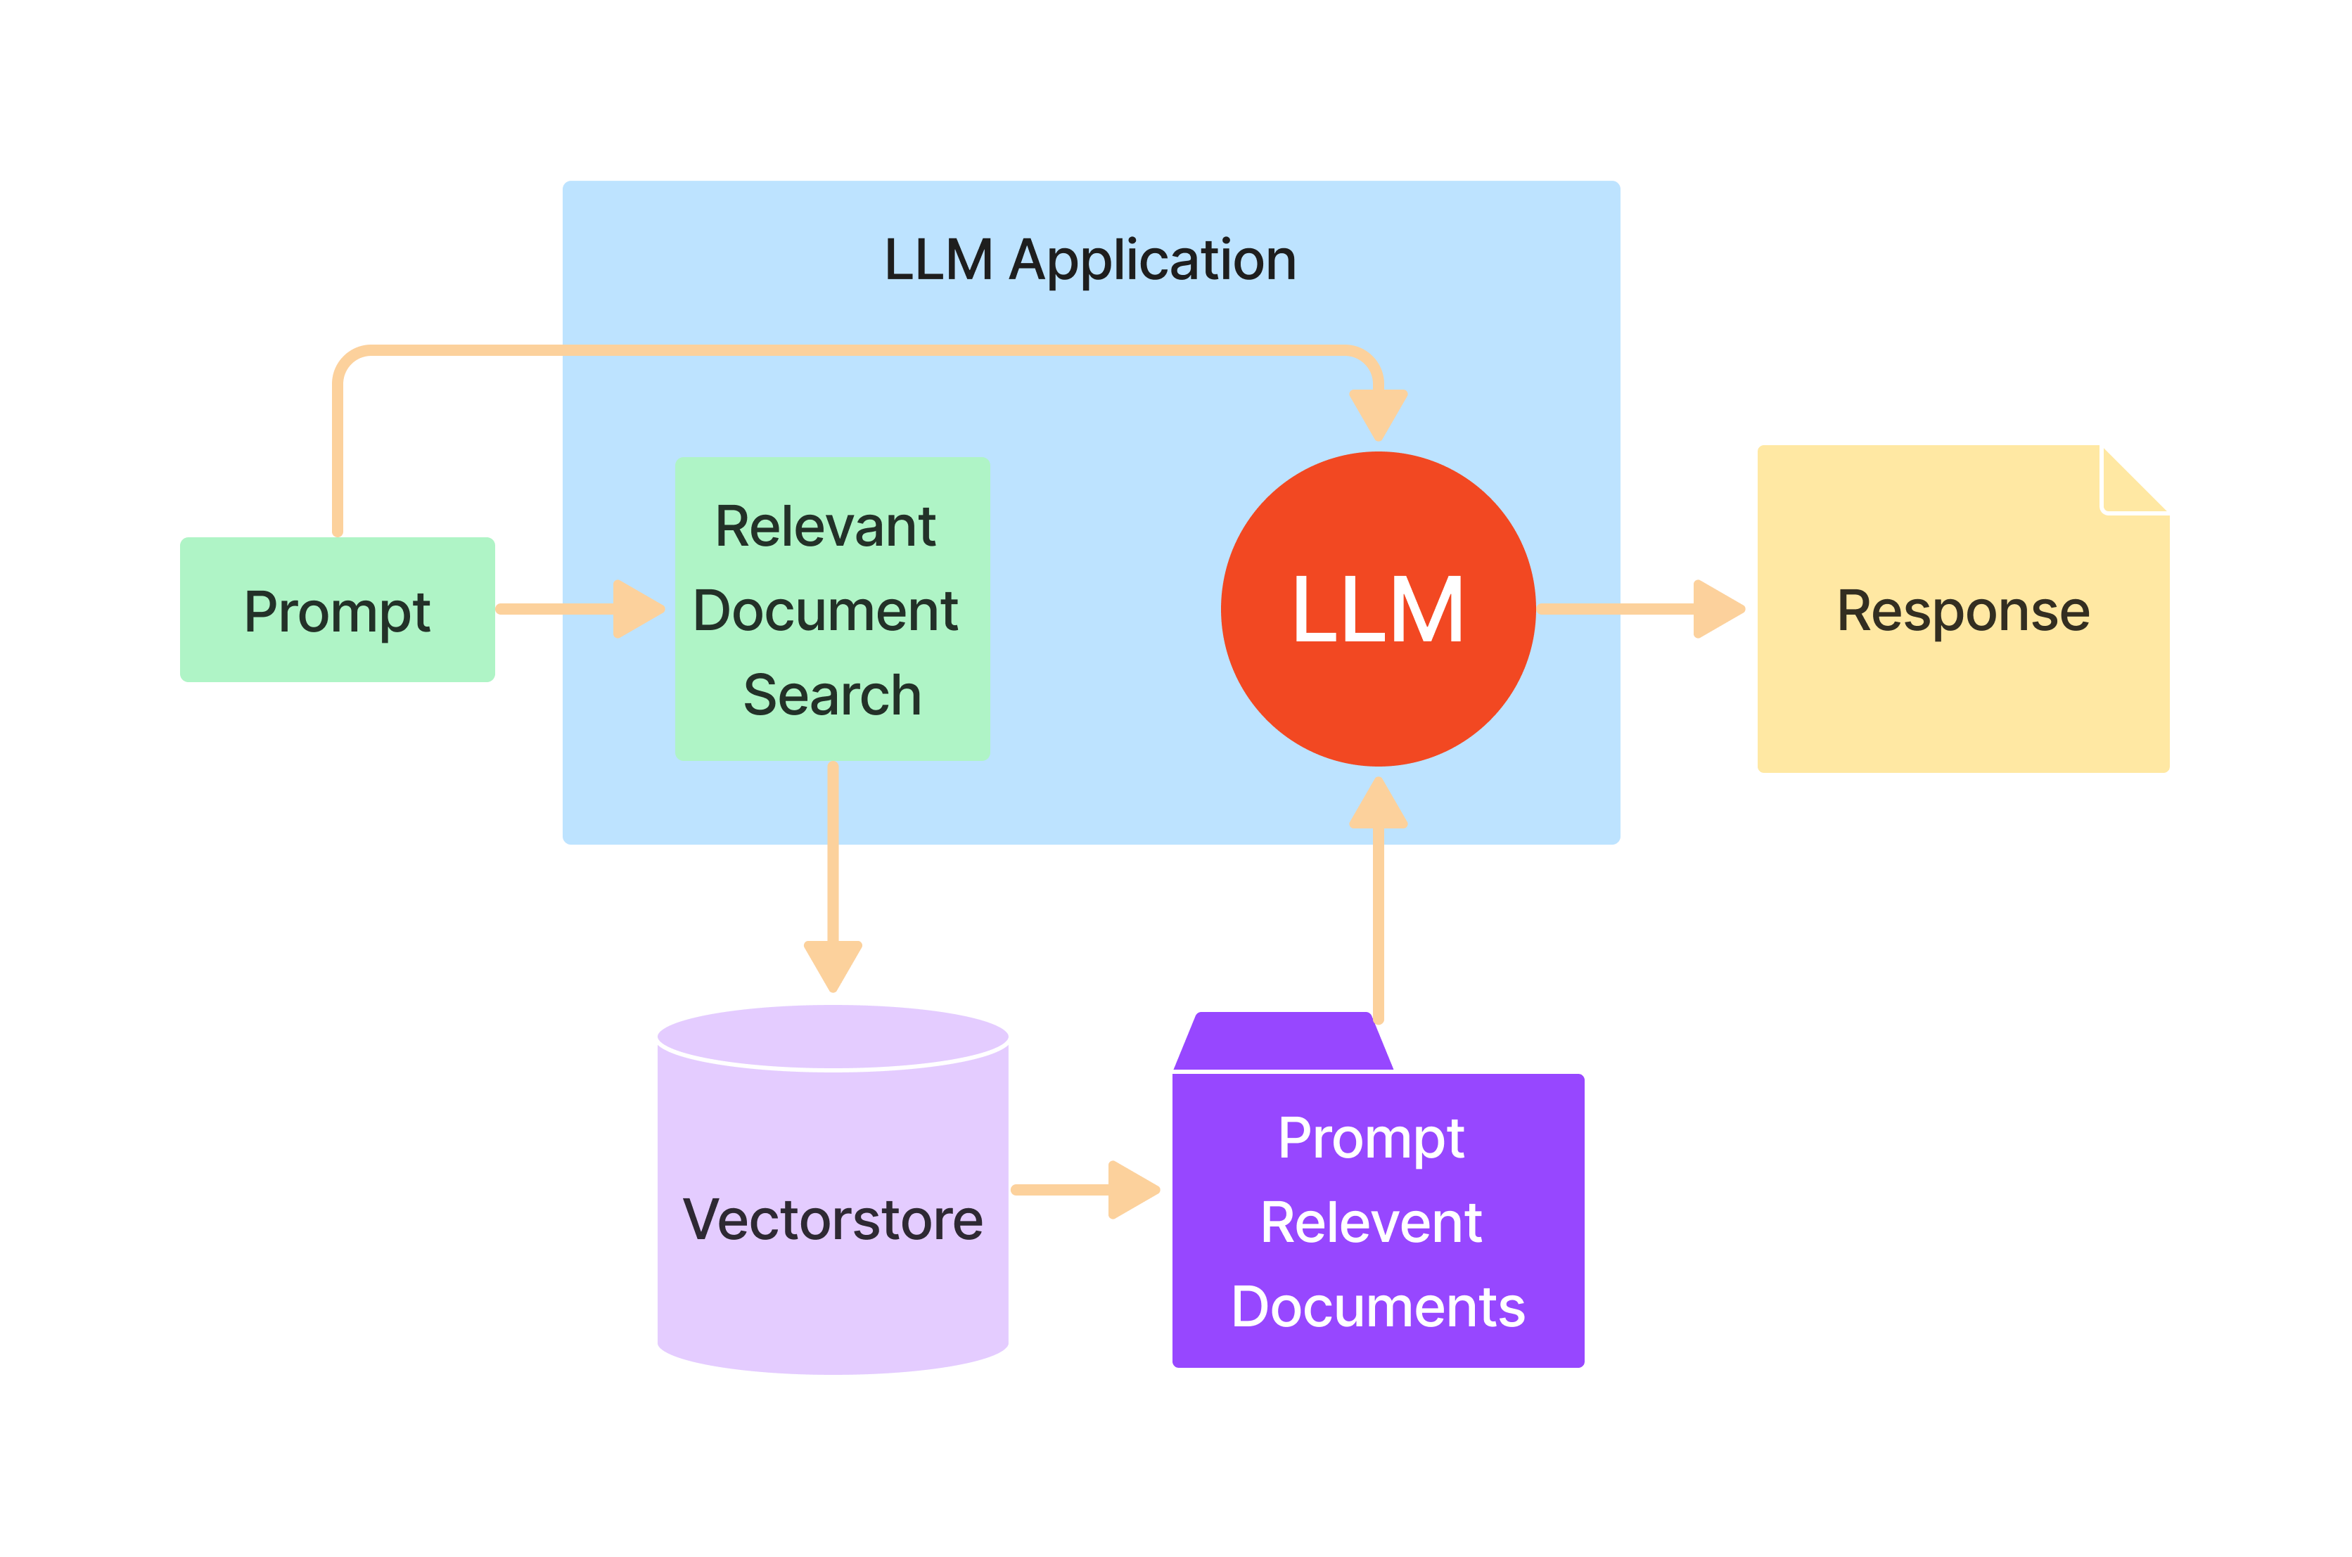
RETRIEVAL AUGMENTED GENERATION (CONT’D.)
Simplified Diagram Depicting RAG in Applications.
Notes:
Nice and simple.

Slide 15

INCORPORATION AND IMPLEMENTATION

Slide 16


Incorporation and Implementation
Using Retrieval Augmented Generation in LLM systems, we can reduce the need to retrain our model.
In applications with models tailored to specific use cases, our initial fine-tuning of the model may be sufficient in setting its long-term behavior.
Body language
Under this notion, we are proposing a YorkGPT system, in which we fine-tune a pre-trained model to fit the intended utilization.
This privately-maintained model is supplemented with Retrieval Augmented Generation to update its working knowledge with recent events, campus and course information, and everything YORK COLLEGE.

Slide 17
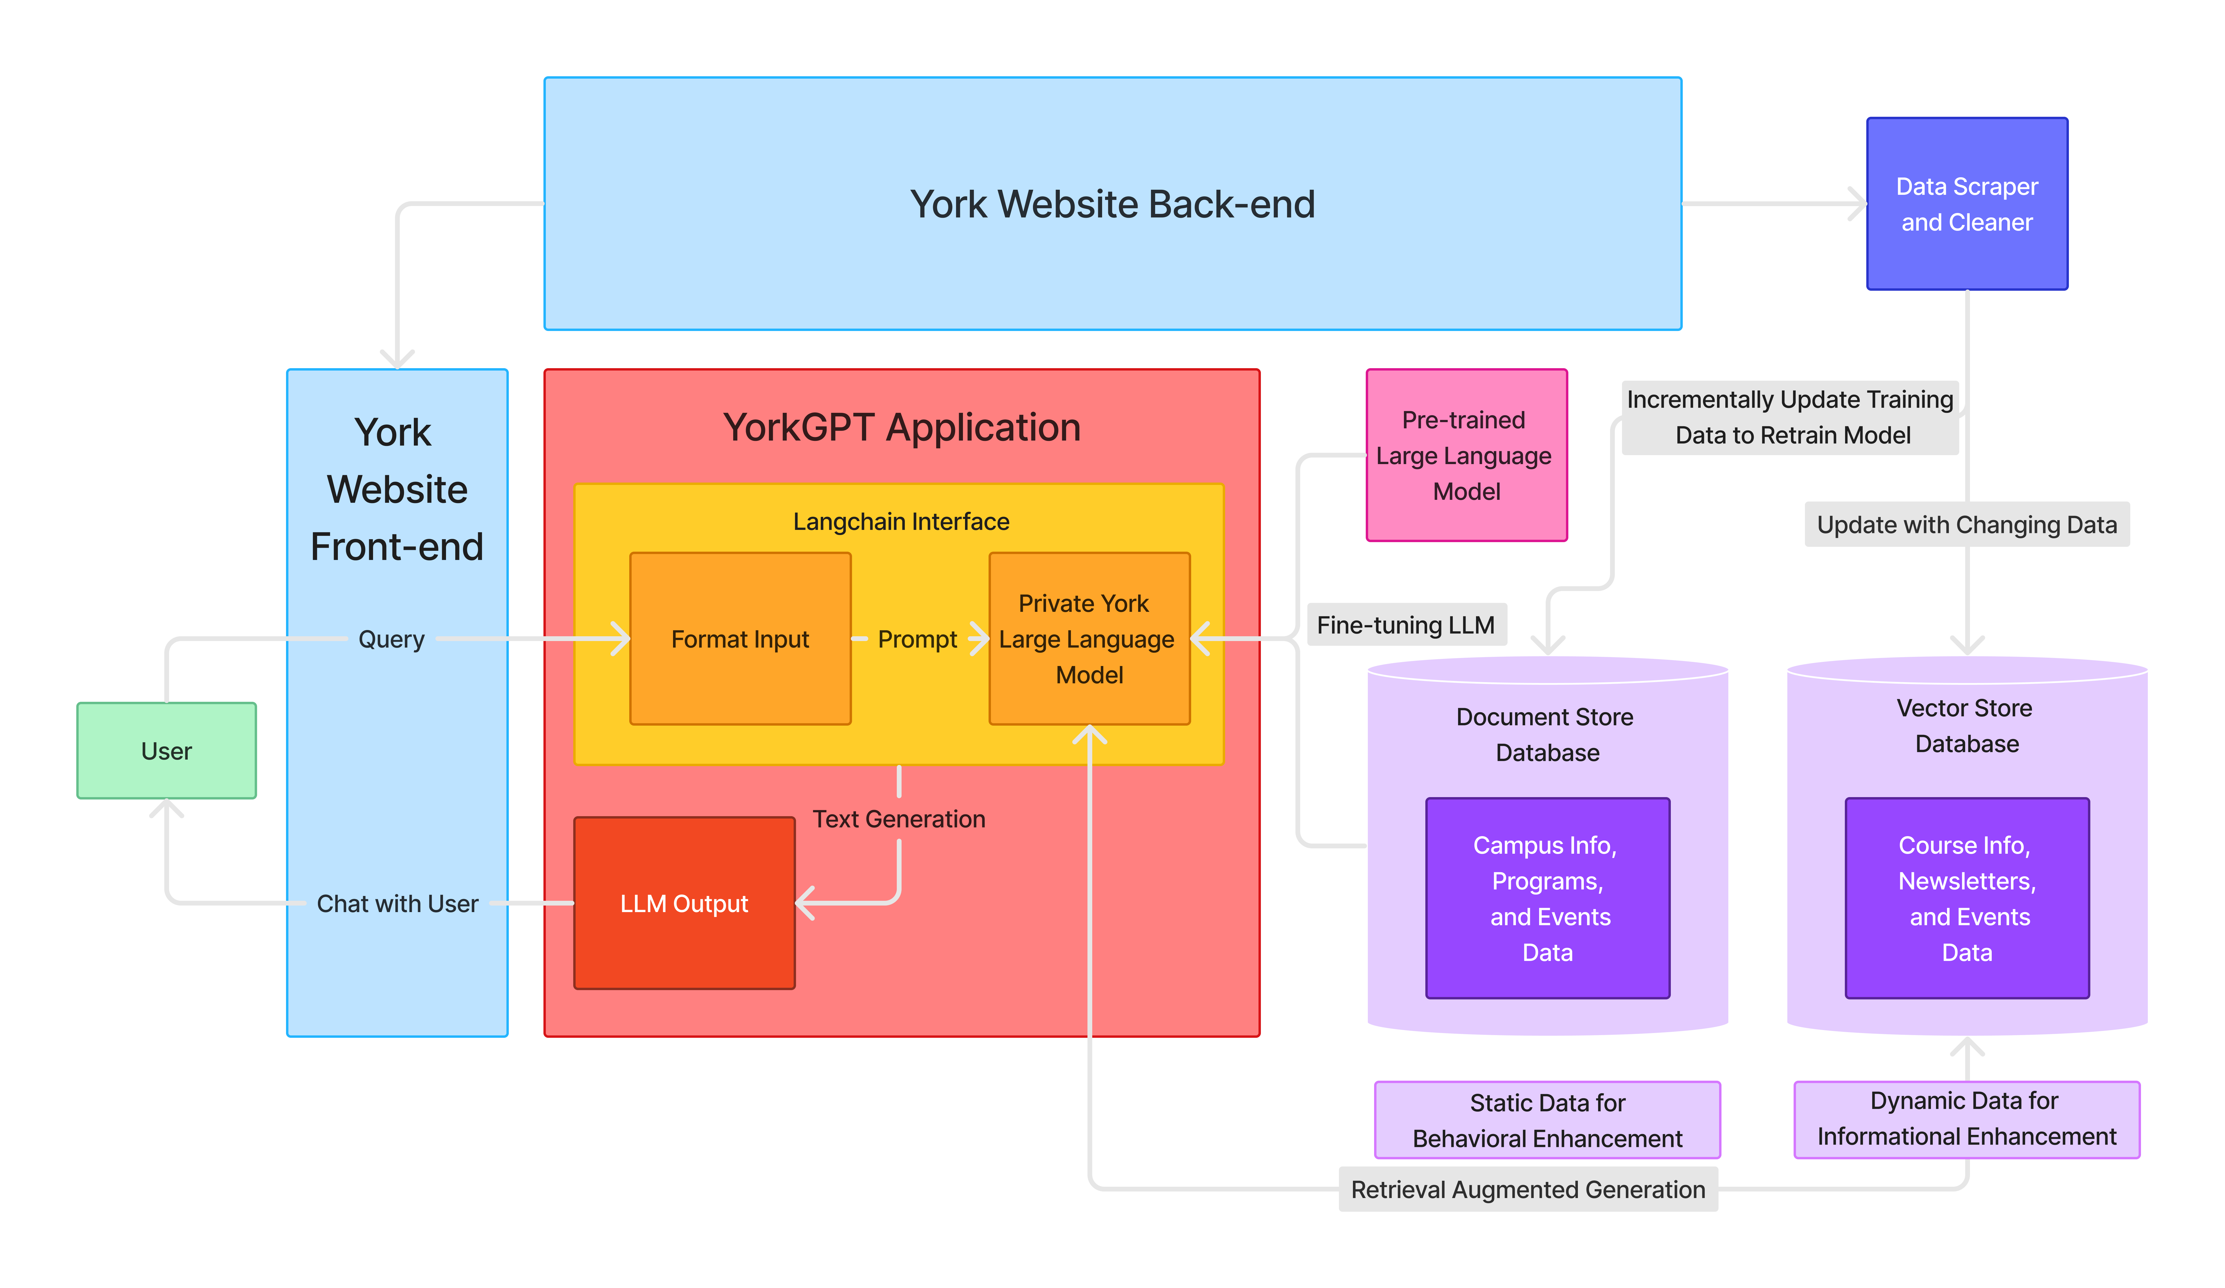
Incorporation and Implementation (CONT’D.)
Body language
Hypothetical System Design For YorkGPT

Slide 18
Incorporation and Implementation (CONT’D)
Of course, as with everything to do with computers, there exist limitations, and RAG is no exception, as:
Body language
datastores for can be very storage, and thus cost, intensive to maintain.
retrieval process can cause latency in the generation of text.
the quality of introduced data can influence the integrity of responses.
Notes:
The proper cleaning and verification of the data can add further complexity to RAG integration. LLM must first fetch specific data from a large, external datastore.

Slide 19

GOING FORWARD

Slide 20
THE FUTURE OF Large language MODELS
As we see for both parameterized training and Retrieval Augmented Generation, computing resources still serves as a limiting factor in their development.
With advancements in compute power and an increase in the availability of supercomputers and GPU processing, utilization of RAG to aid in continuous fine-tuning could become more feasible, as well as the use of LLMs during training.

Slide 21
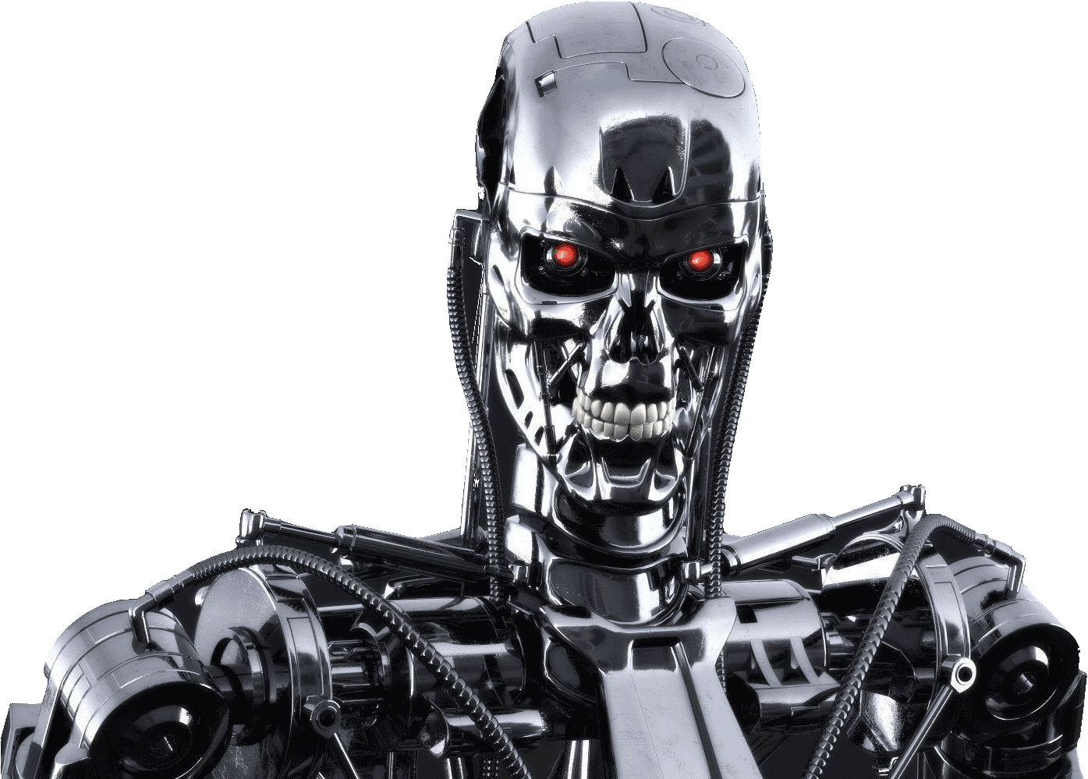
THE FUTURE OF Large language MODELS
I look forward to a future where AI takes over (In the sense of widespread use, of course).
Notes:
Just a lighthearted slide. I like energetic presentations.
This is a terminator reference. (AI takes over humanity.)

Slide 22
THANK YOU.
Darryl Nurse
Computer Science (BS) Major, S-STEM Scholar
Email: darryl.nurse@yorkmail.cuny.edu

Slide 23
Questions?

